Slide 1





Progresses in project activities for EULS
Milestone 1 and 2
May – October 2011

Slide 2
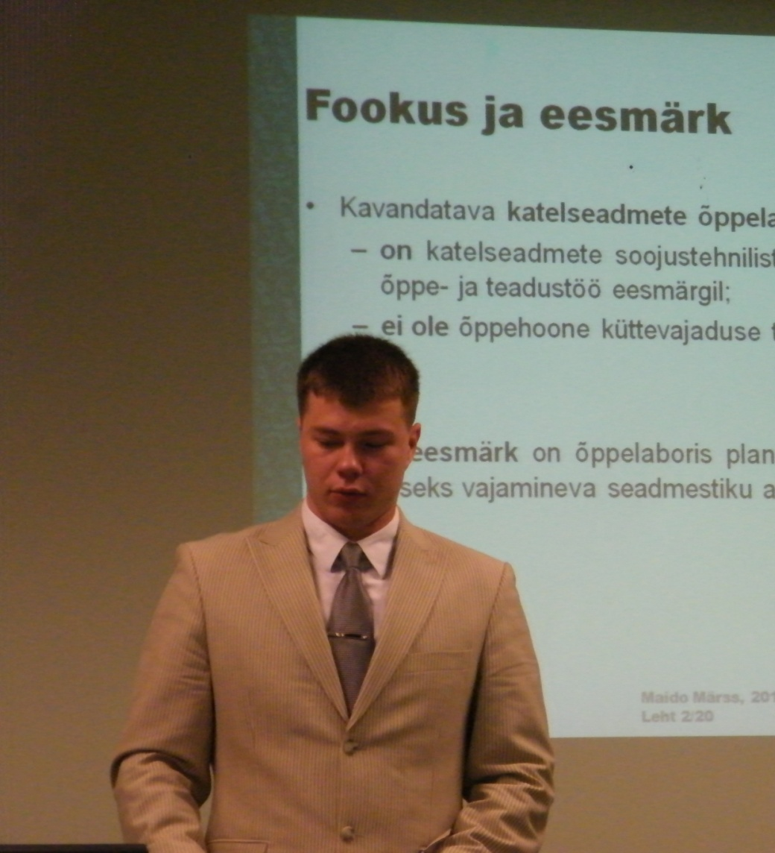
May 2011
Starting the project
Planning activities MS1
Supervising of MS.stu-dent Maido Märss
Producing of first set „Horsepower
Kick off seminar in TTS

Slide 3
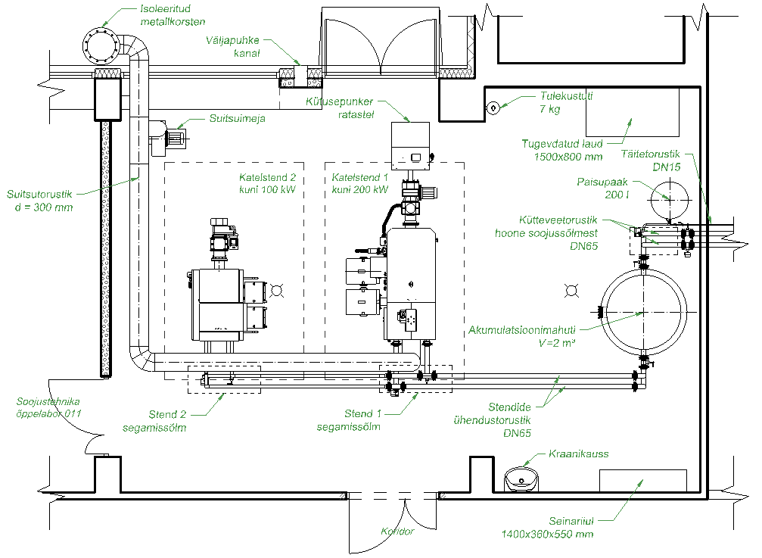
Overwiev of boiler laboratory Author M. Märss

Slide 4
Equipment on flue gases Author M. Märss

Slide 5
June 2011
Making of second set „Horsepower“
Building of „Solardryer“

Slide 6
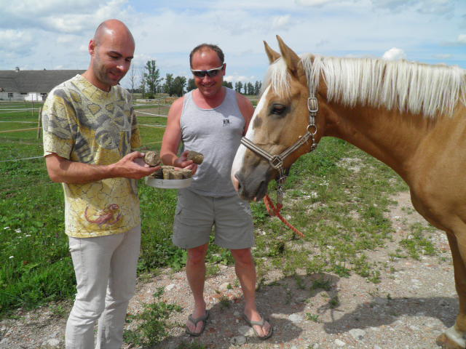
Fuelset „Horsepower1“

Slide 7
July 2011
Preparing on fuel
Introducing of „Horsepower“ in newspaper „Greengate“
http://www.greengate.ee/?page=779

Slide 8
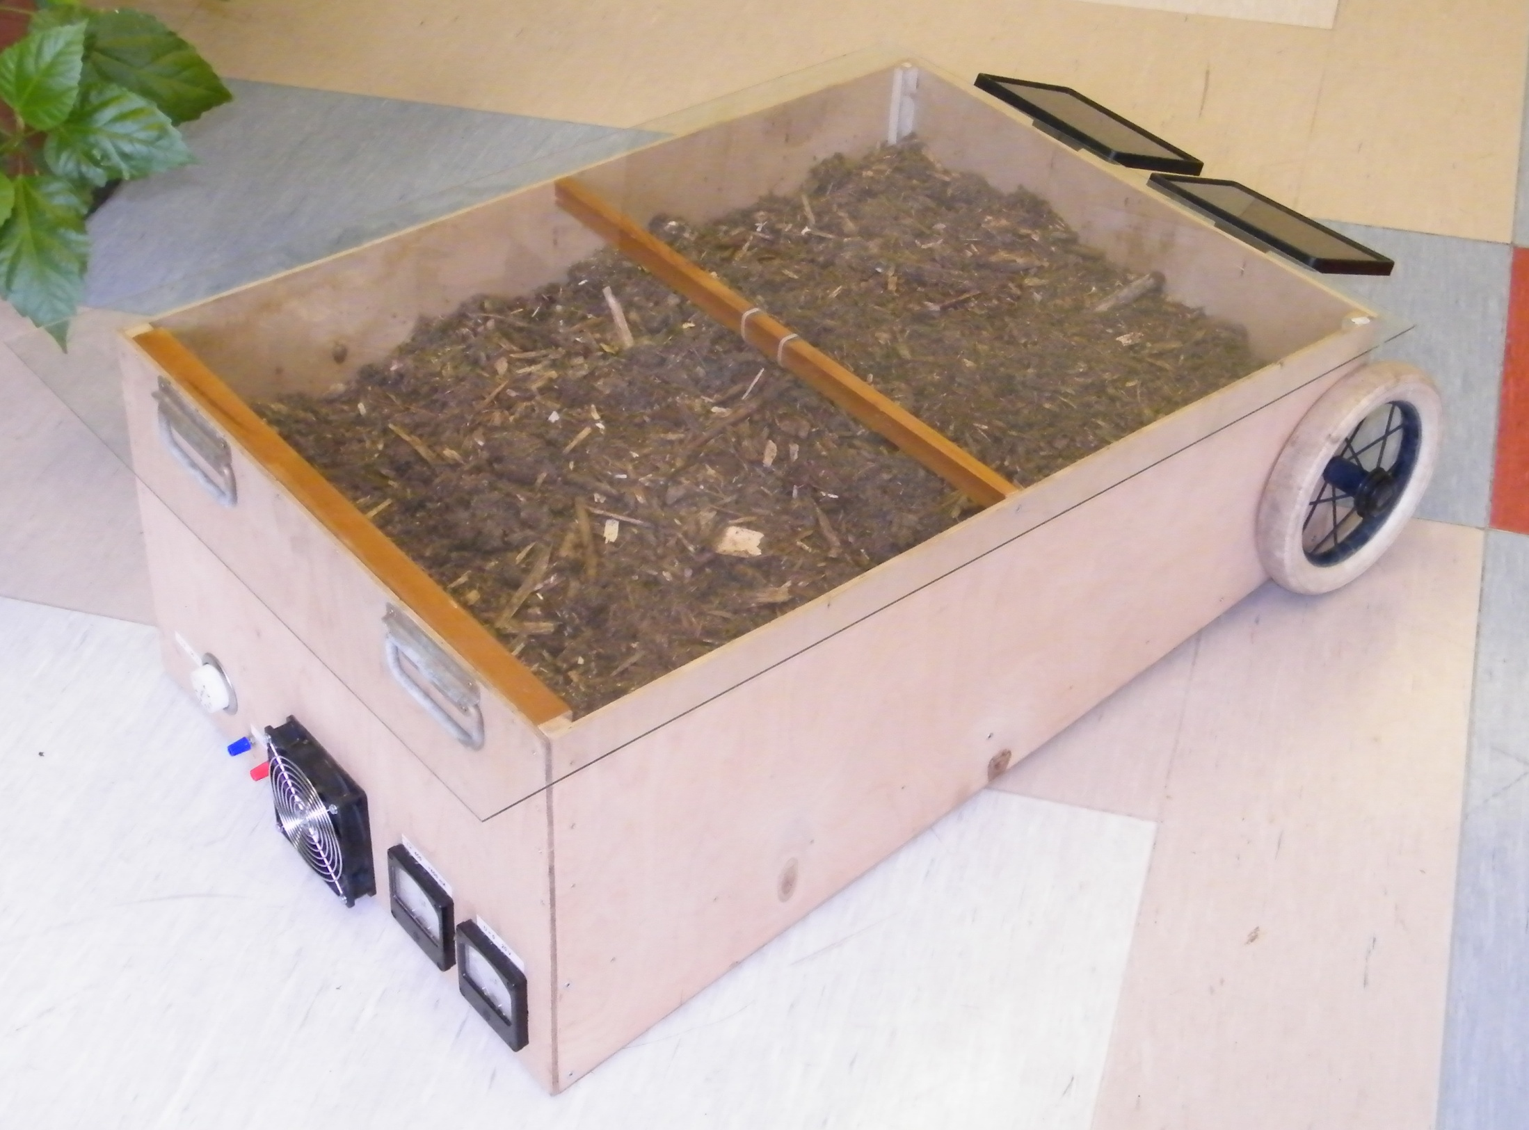
„Solardryer“

Slide 9
August 2011
Collecting data for e-lerning
Preparing the course „Boiler equipment“ (Katelseadmed)

Slide 10
September 2011
Preparing of articles to TEUK
Starting course in EULS „Katelseadmed“
Consulting of Mäksa council
Studytrip to Kunda
Night of the Scientists

Slide 11
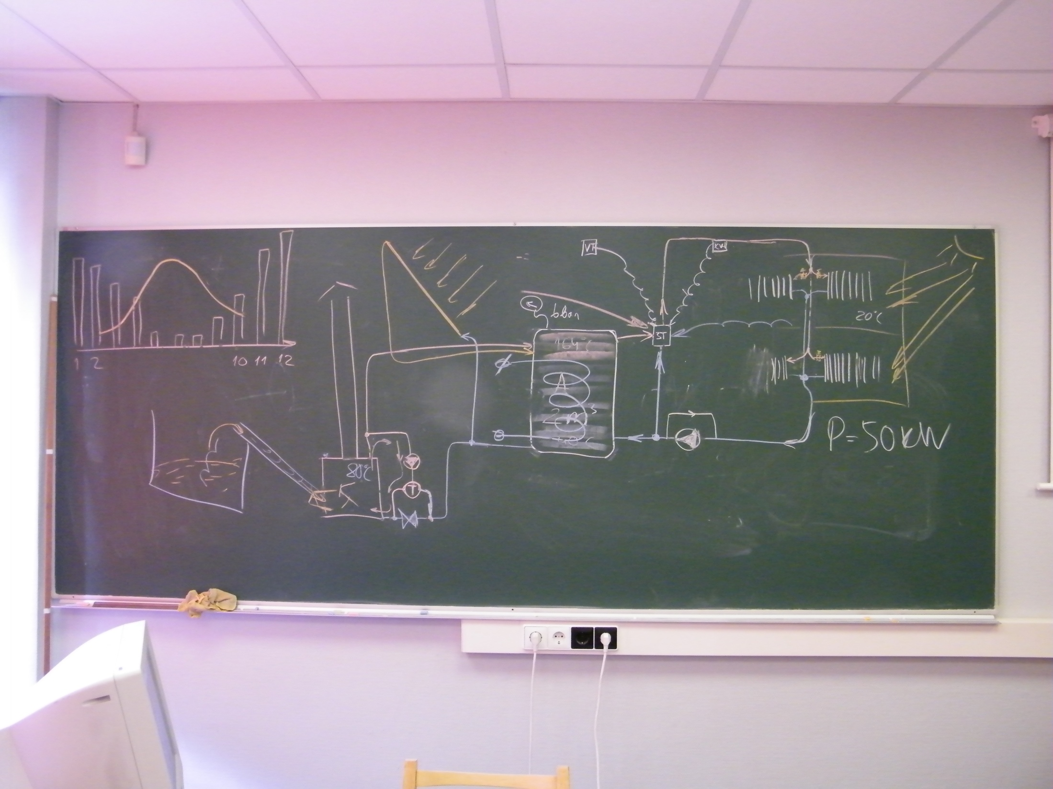

Slide 12
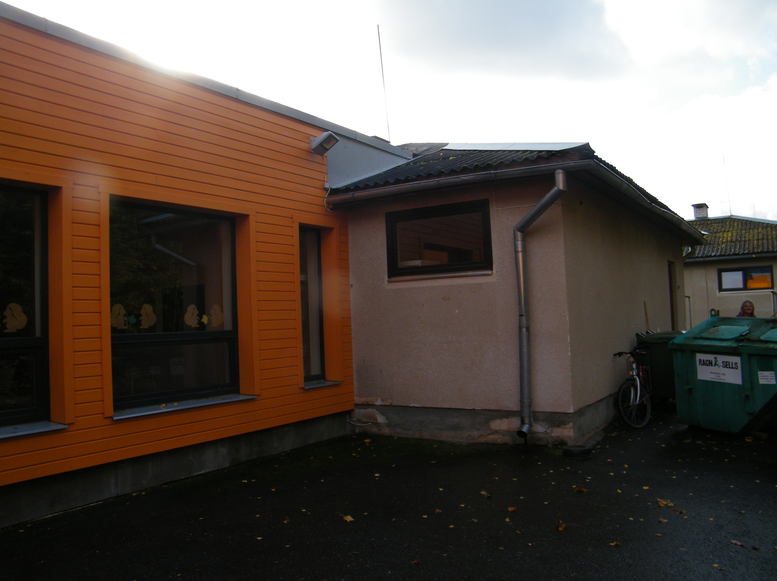

Slide 13
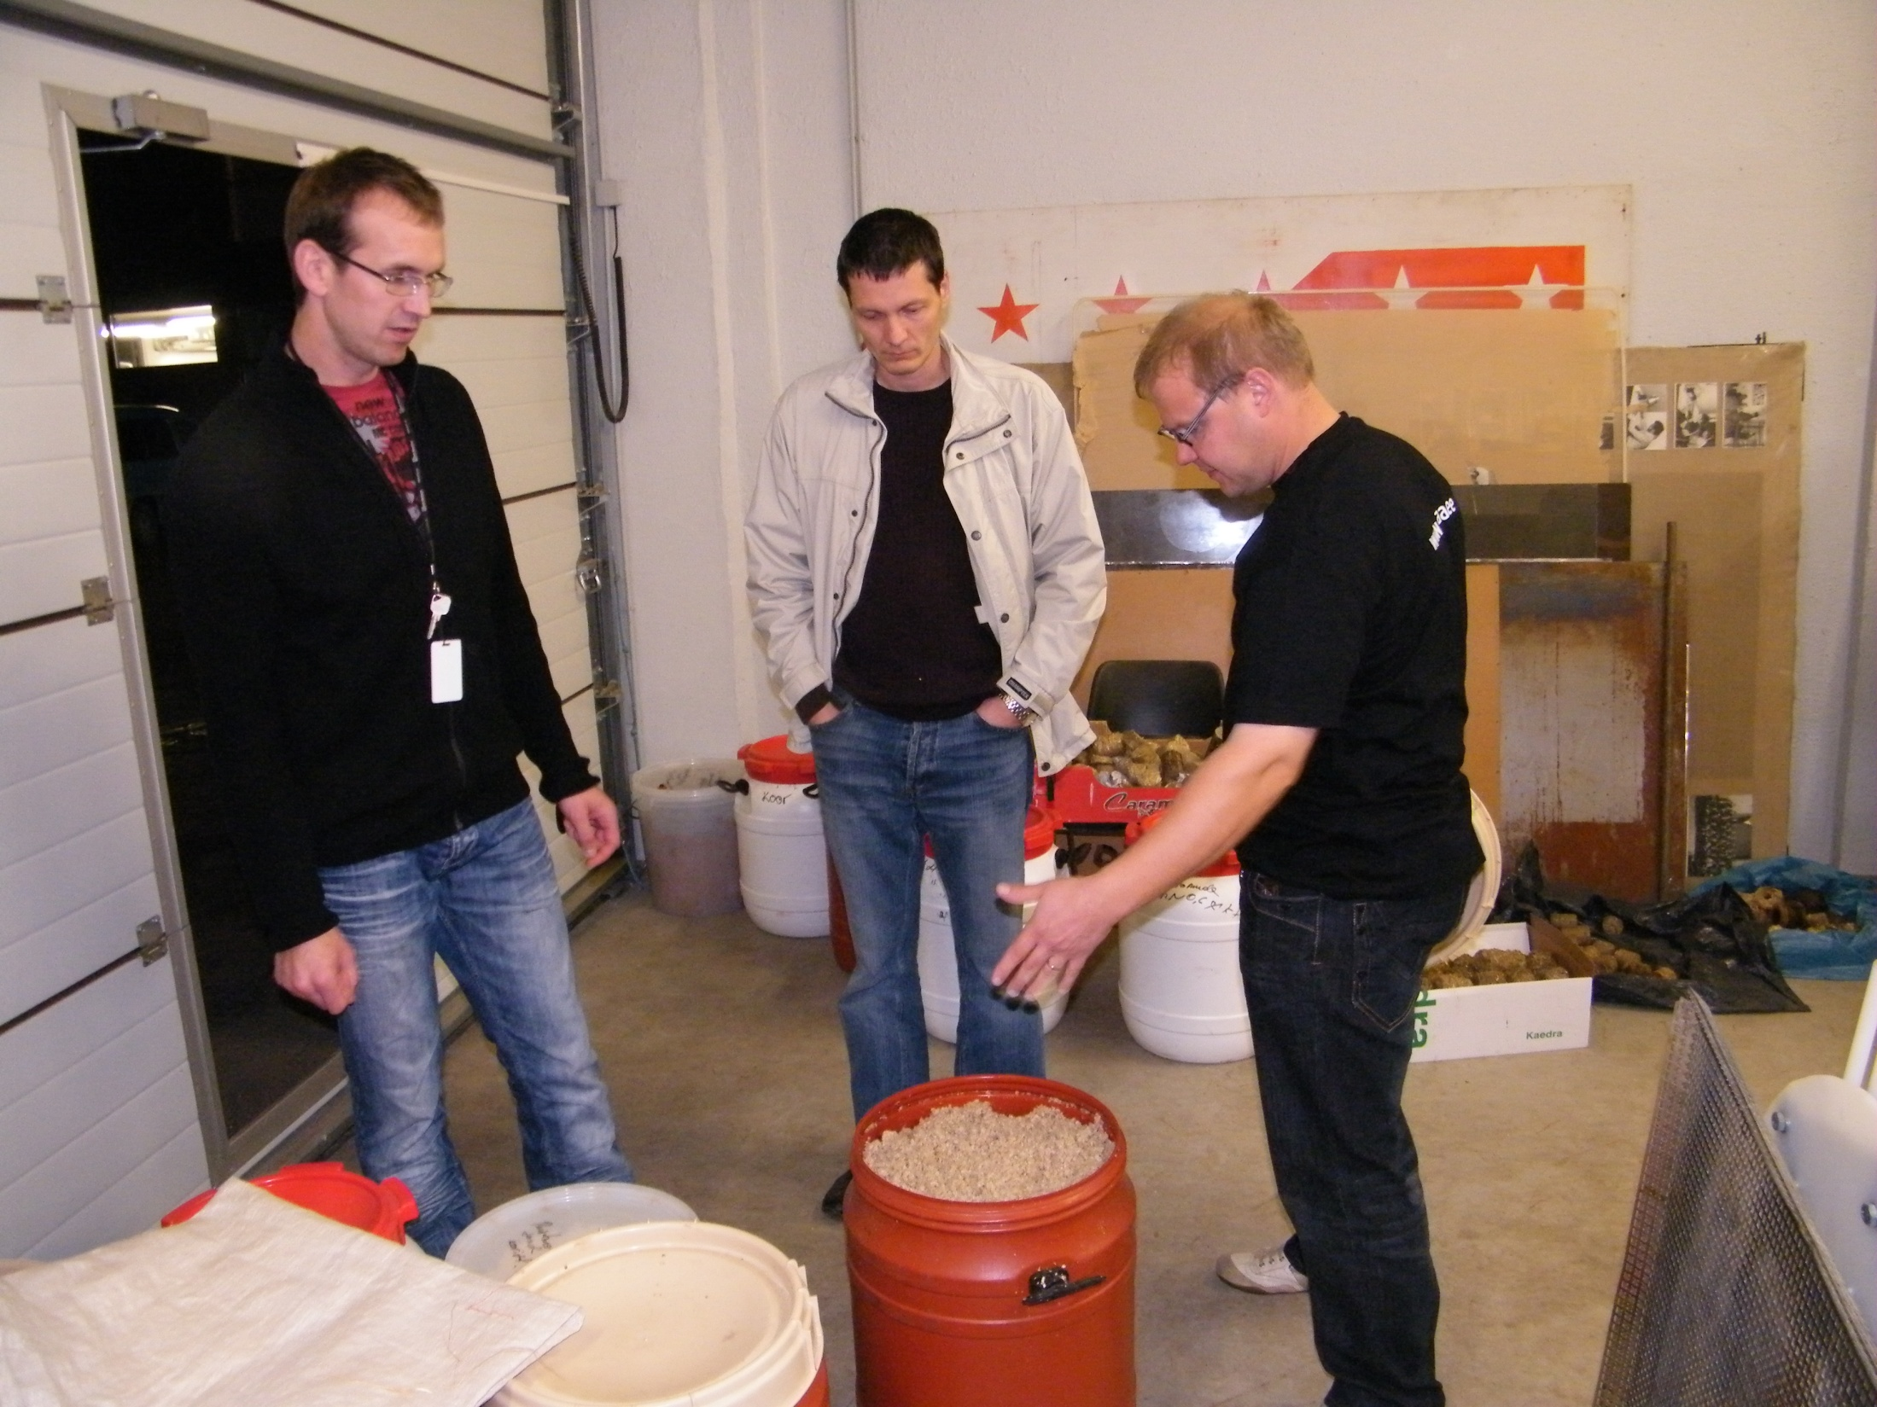

Slide 14
October 2011
Burning days in TTS

Slide 15
