Slide 1
New types of fireplaces for the local heating in Estonia and experiments in boiler laboratory
Mart Hovi
Estonian University of Life Sciences
2013

Slide 2
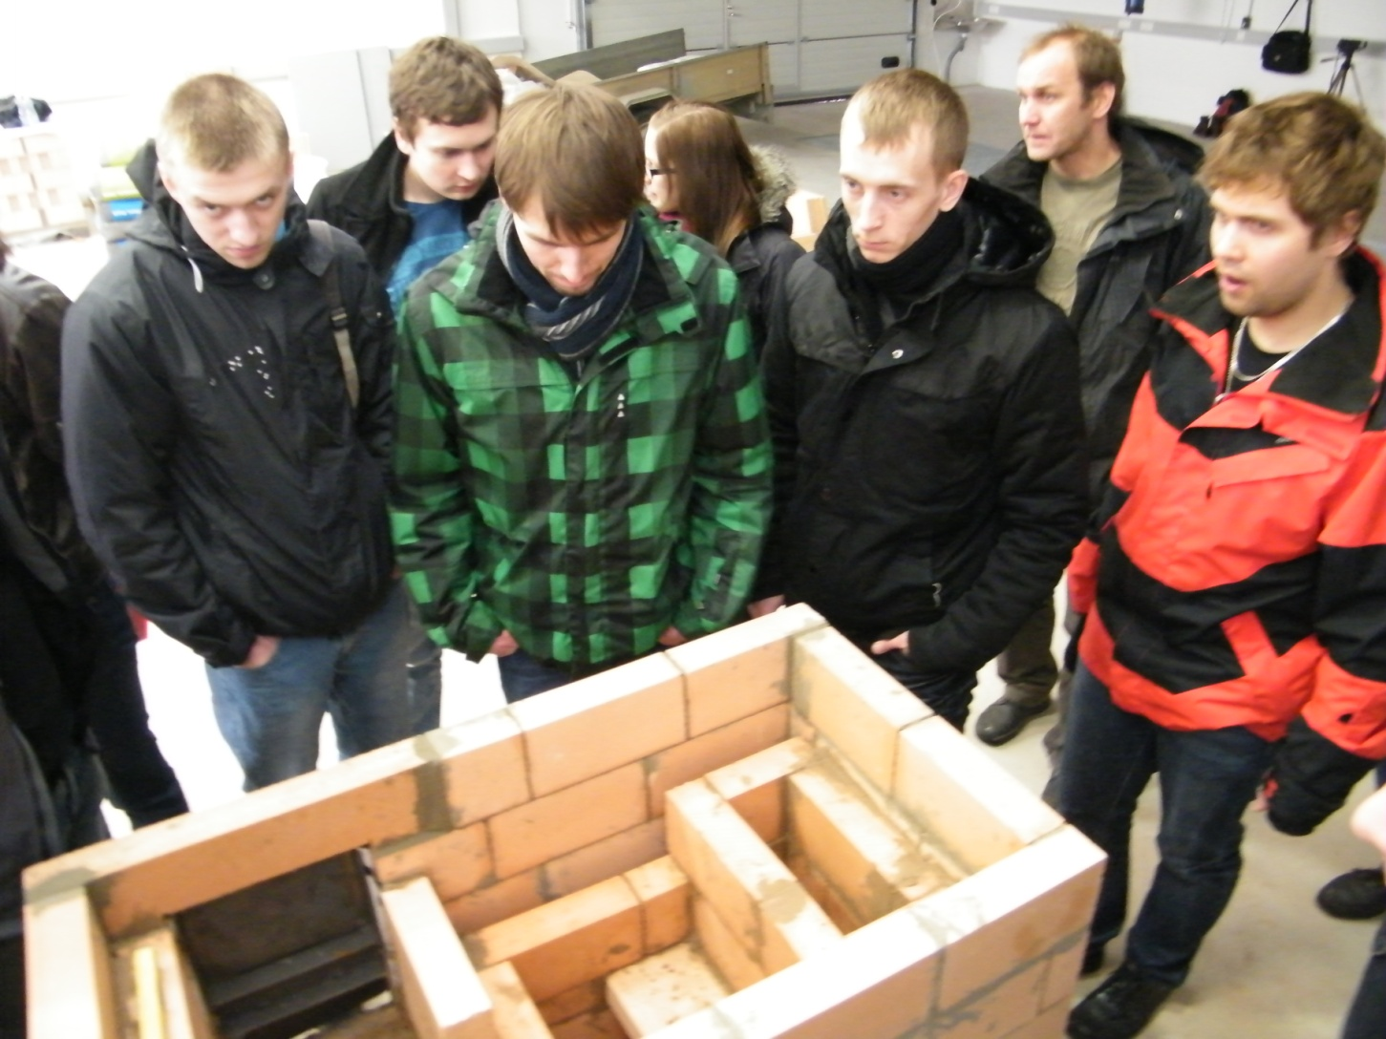
Constructing

Slide 3
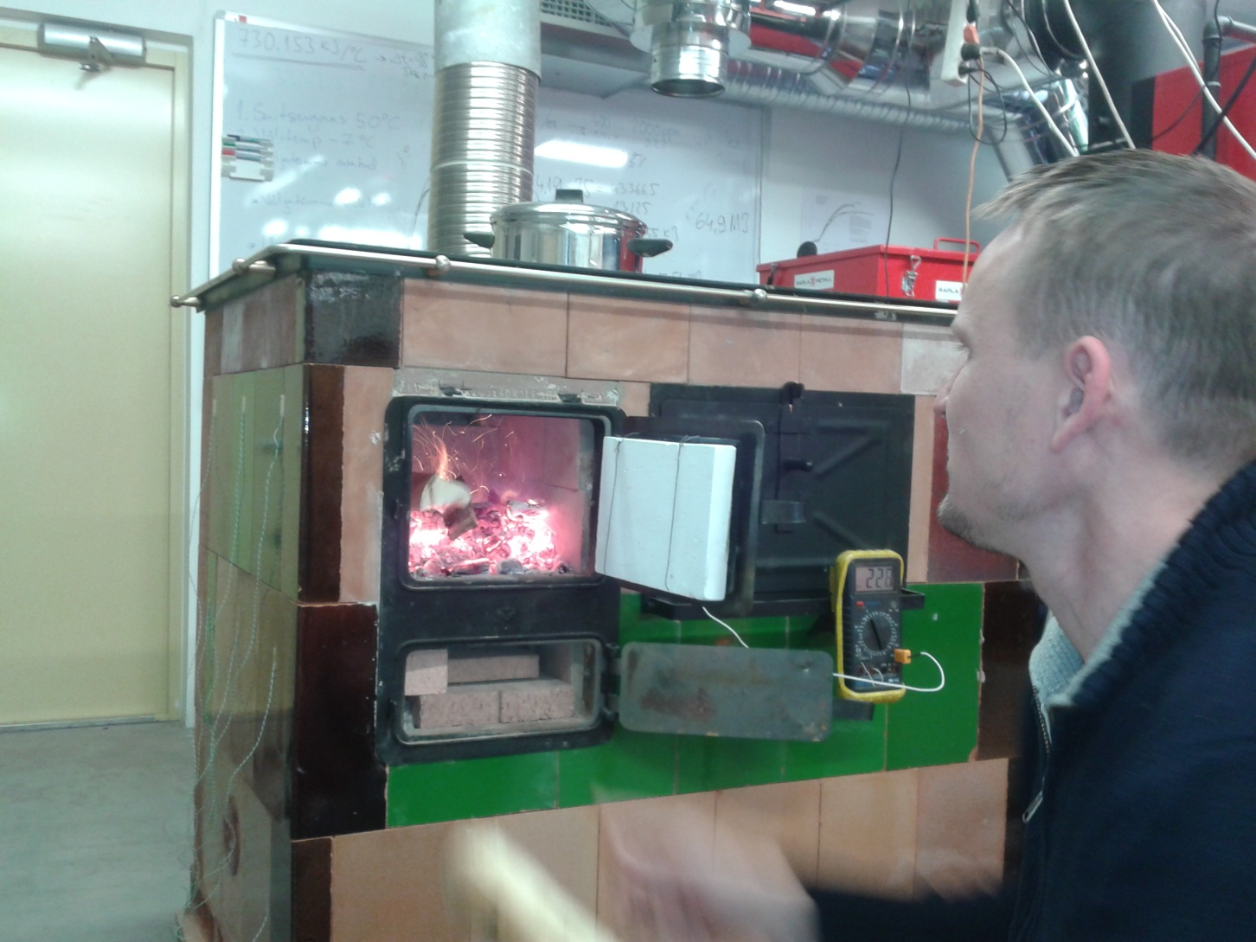
Testing

Slide 4
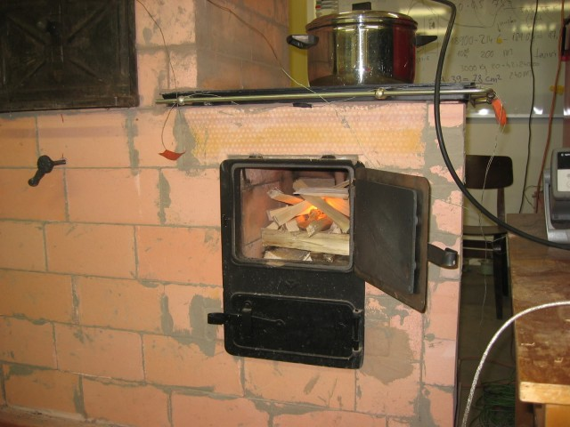
Measuring

Slide 5
Best results

Slide 6
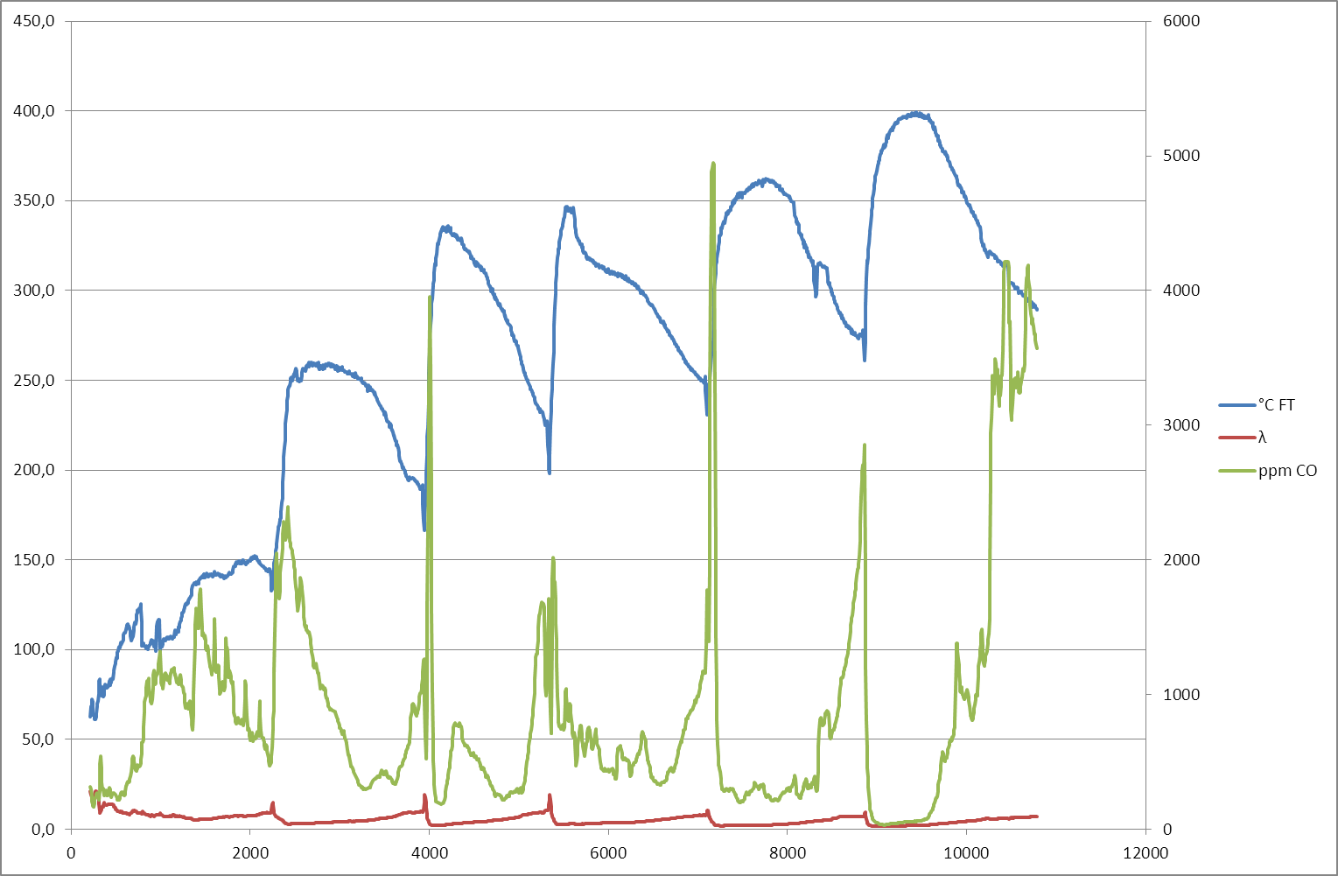
Measurements

Slide 7
Standard EN12815
Residential cookers fired by solid fuel ― Requirements and test methods
Herde für feste Brennstoffe ― Anforderungen und Prüfung
Cuisiniéres domestiques à combustible solide ― Exigences et méthodes d'essai
Tahkel kütusel töötavad paiksed autonoomsed boilerid. Nõuded ja katsemeetodid

Slide 8
Boiler lab. experiments
Heat acumulator as measurement device

Slide 9
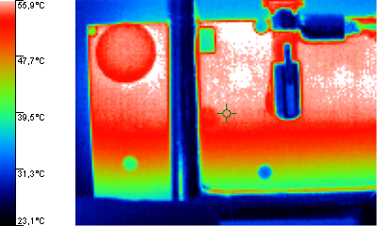
Acumulator IR picture

Slide 10
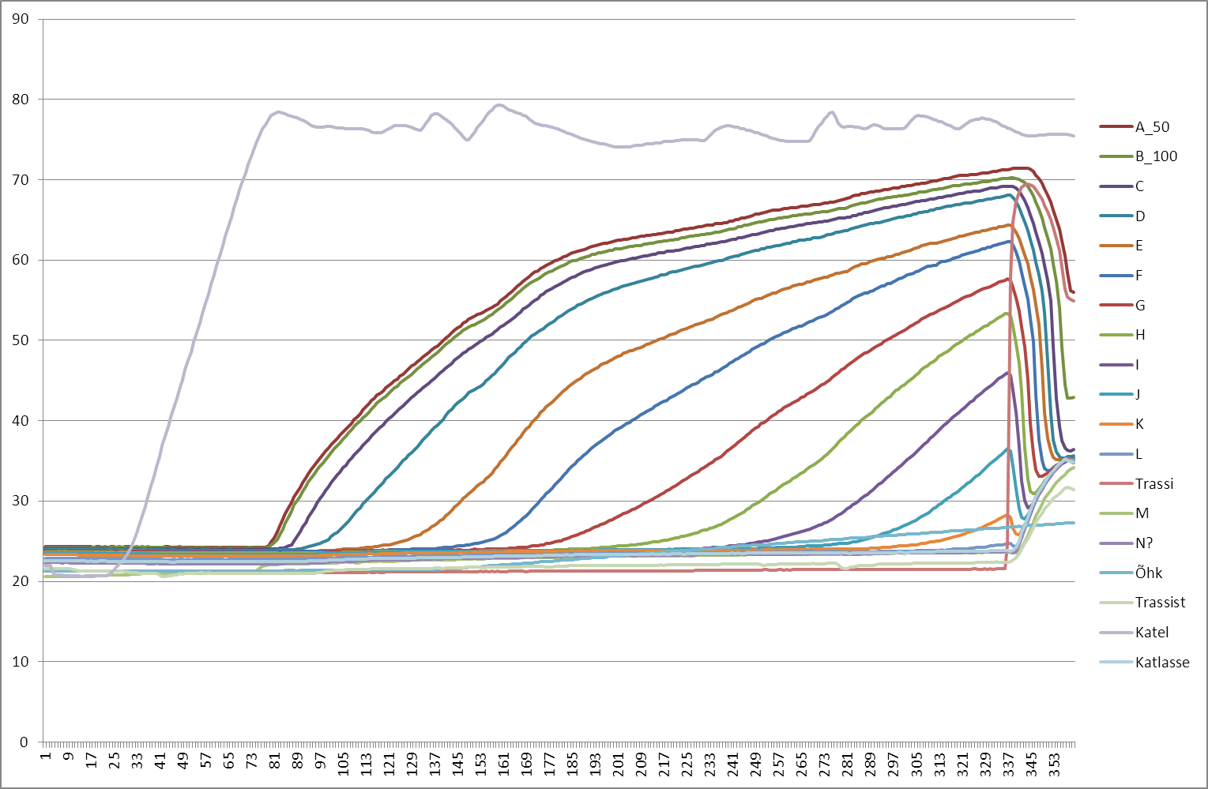
Surface temperatures

Slide 11
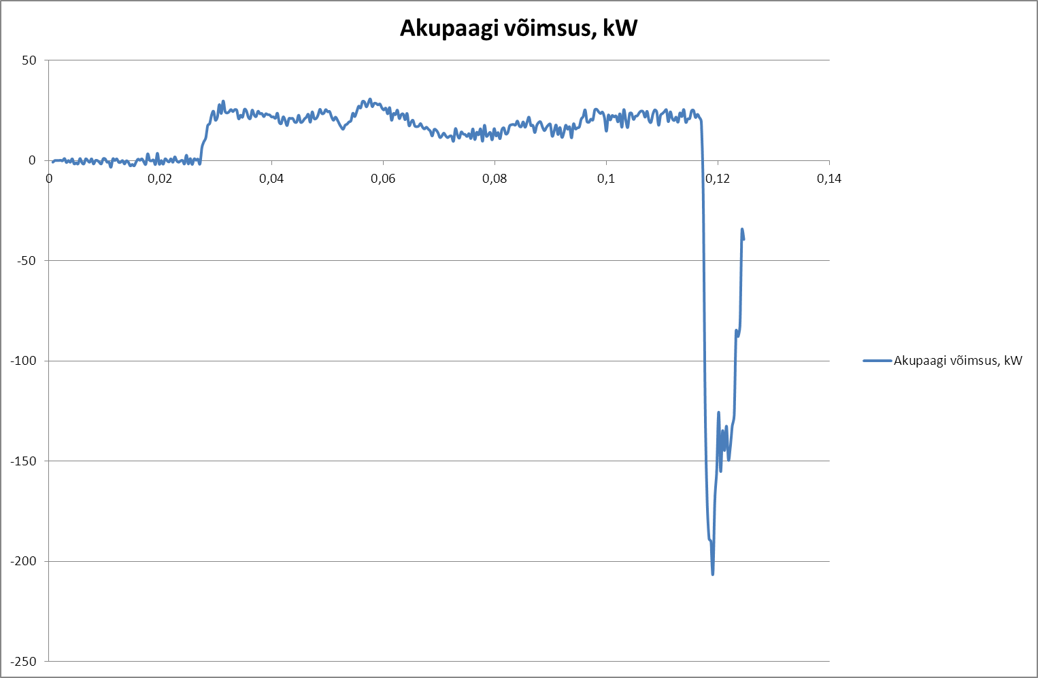
Accumulator power in/out

Slide 12


