Slide 1
ECOHOUSING WG1
activities carried out within the project in EULS

Slide 2
Project seminars

Slide 3
Boiler lab of the Estonian University of Life Sciences
In order to study the parameters of available fuels and to test boilers using biofuel, a boiler lab was established at the Estonian University of Life Sciences in 2013. The purpose of the tests carried out by the lab is to support studies in technical fields, to introduce the standards applicable to the relevant equipment and fuels, to make proposals for the improvement of boiler equipment based on heat release rates of the external surface of boilers and the characteristics of different types of fuel, to analyse the parameters of the fuels used together with fuel wood and to introduce the findings to users. As the lab is operating at a university, its main purpose is to support studies in technical fields, notably bachelor and master studies in the field on energy use. The boiler lab enables us to verify the results of theoretical calculations, by conducting experiments on heat technological tests. Although the main purpose of the lab is to support studies, it is also conducting tests in cooperation with producers to examine the qualities of fuels and to optimize burning technologies. The collected data can be used to determine optimal operating regimes for boilers.
http://www.eby.ee/ajakiri2013.pdf

Slide 4
Experimental setup

Slide 5
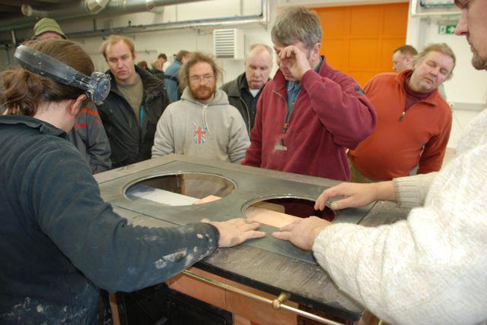
Classes for Installers

Slide 6
DVD record from course
Let’s see a video ..

Slide 7
Study trip in South-Estonia
Kymene factory
- Fuel from residues of wood factory
Põlva boiler factory
- boilers for local fuel heating

Slide 8
In Kymene Otepää
http://www.eby.ee/Ajakiri_2012.pdf

Slide 9
In Põlva boiler factory

Slide 10
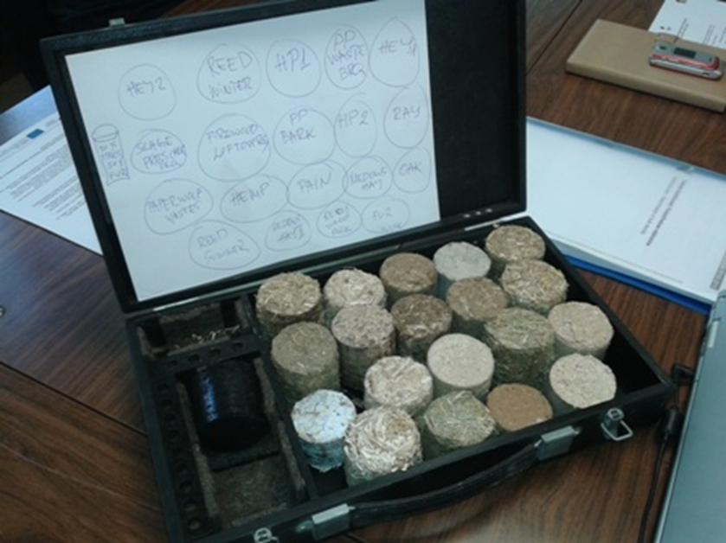
Fuel from waste
Bio-fuel briquette samples

Slide 11
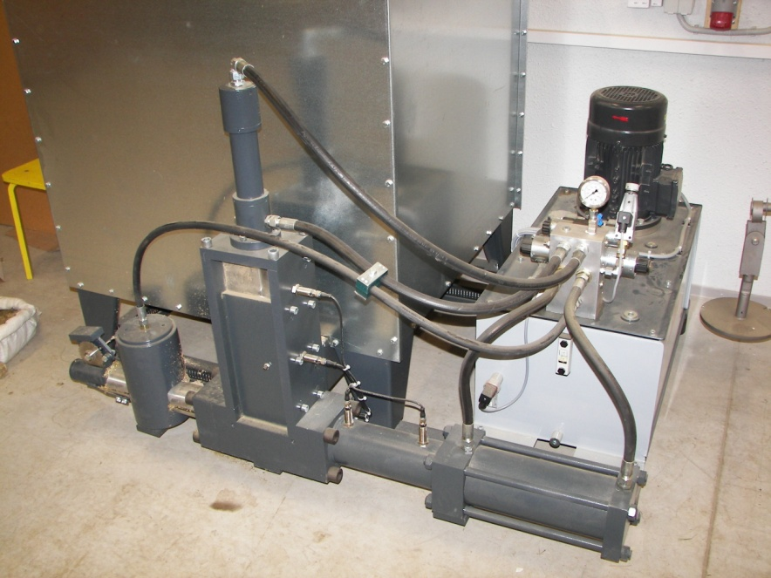
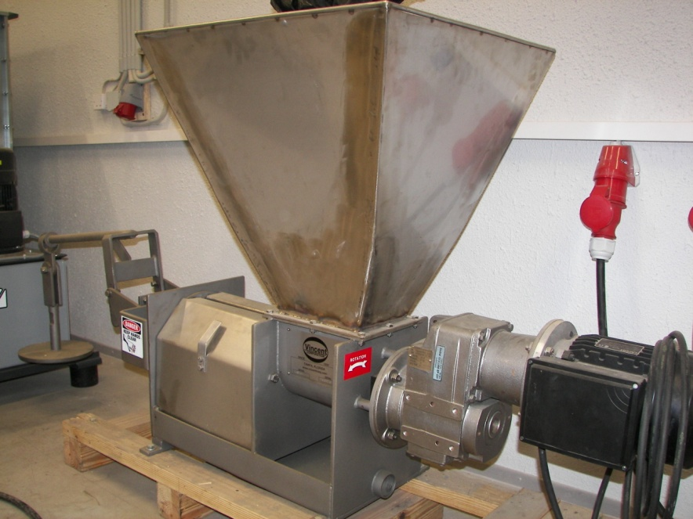
Main facility (Briquetting)
Grinding: A mill RS06
Dewatering of silage: screwpress Vincent CP4
Briquetting: press Weima c-150
Weima C-150
Vincent CP4

Slide 12
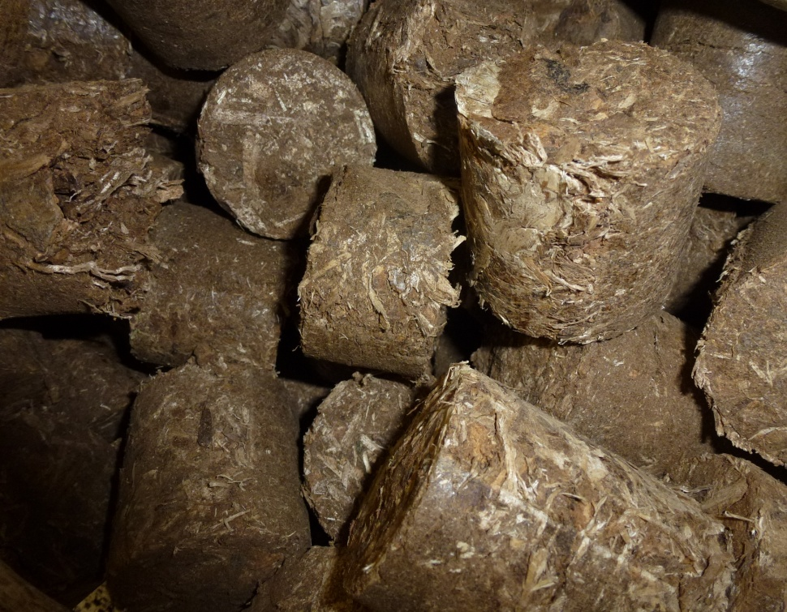
RD Briquettes
Fig. 1. Briquettes made from pulp rejects (PR).
Fig. 2. Briquettes made from bark and wood residue.

Slide 13
RD Biogas
Methane yield test results and process activity of SAD, PFS and PRPF.

Slide 14
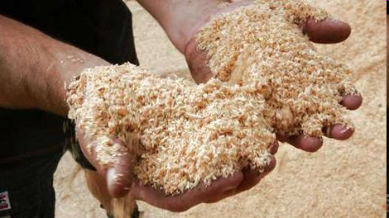
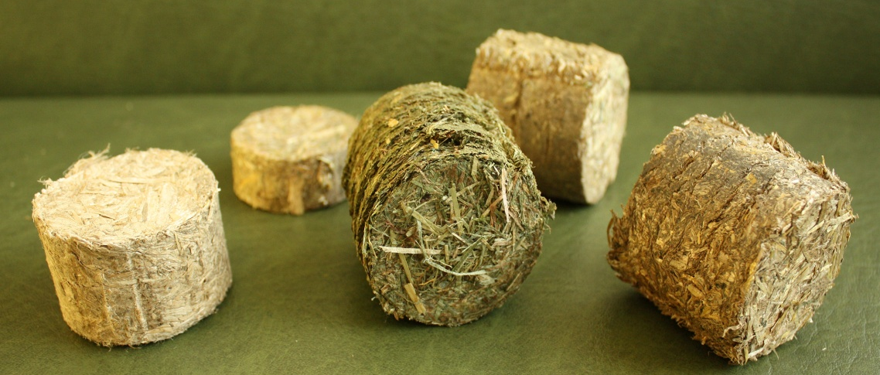
Introduction
Wood fuels can be divided into two major groups:
non-refined wood fuels (traditional firewood, compressed forest residue, wood chips, sawdust)
refined wood fuels (briquettes, pellets, wood powder)

Slide 15
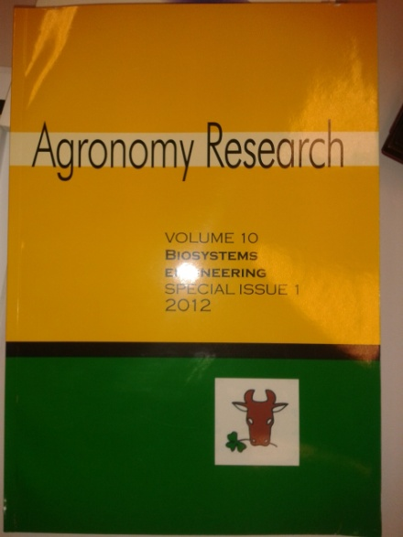
Agronomy 2012
Pretreatment and usage of pulp and paper industry residues for
fuels production and their energetic potential
A. Menind1, L. Oper2, M. Hovi1, J. Kers3, M. Tutt1 and T. Kikas1
This paper gives an overview about Pulp and Paper Industry (PPI) residues, their properties and some solutions for converting those materials into fuels. The main leftovers are bark, sludge of aerobic digestion, primary floto sediment (PFS) and pulp rejects (PR). PFS and PR after applying dewatering (press fluids) have considerable biogas potential. Bark and press cake of PR are a good resource for briquetting. Ethanol potentials of bark and PR cake are presented

Slide 16
Agronomy 2013

Slide 17
TEUK 2011 A
SOLID BIOFUEL FROM CONIFER-CHIP HORSE BEDDING
Mart Hovi, Külli Hovi, Andres Menind
A set of experimental biofuel called „Horsepower“ was produced in Estonian University of Life Sciences. The wood based compact fuel contains 90% cutter chips and 10% horse manure. Homogenized and pre-dried raw material was pressed into a briquette. There are special manners how the unprocessed substance should be preserved. The density of the fuel is higher than it is of wood logs.
http://tek.emu.ee/userfiles/taastuvenergia_keskus/TEUK%20XIII/TEUK-XIII_kogumik_web.pdf

Slide 18
TEUK 2011 B
EXPERIMENTAL SOLAR DRYER
Mart Hovi, Külli Hovi, Andres Menind
The experimental solar dryer was built in Estonian University of Life Sciences (EMÜ). The equipment uses solar energy in two different ways. Firstly, solar energy is used for the heating of air that is absorbed during the process. Second purpose is to produce electricity. 12V DC is used
for the operation of a fan. Dryer is aimed to prepare fuel samples before briquetting or to perform other tasks if low moisture content is needed.
http://tek.emu.ee/userfiles/taastuvenergia_keskus/TEUK%20XIII/TEUK-XIII_kogumik_web.pdf

Slide 19
TEUK 2012
EXAMINATION OF OVENS FOR PROJECT ECOHOUSING
Mart Hovi, Andres Menind, Külli Hovi, Argo Ladva, Annes Andresson
Partners from EMU of Project Ecohousing and external experts examined the deployment of renewable energy within the solid fuel ovens in southern Estonia. 12 ovens were tested. The results show that the fi replace, piping and accumulative part should function compatibly. However, sometimes it is not so. Constructional errors occur for some newer heating devices. As a result, the temperature of flue gas is high which causes heat-loss and inflammability. Simple smoke thermometer can help in the observation of the behaviour of the equipment.
http://tek.emu.ee/userfiles/taastuvenergia_keskus/TEUK_XIV/TEUK-XIV_kogumik_web.pdf

Slide 20
TEUK 2013
THE CONDITION AND DEVELOPMENT OF LOCAL SOLIDFUEL HEATING DEVICES IN ESTONIA AND IT'S NEIGHBOURHOOD
Mart Hovi, Annes Andresson
The possibilities for local heating can be fairly different in monetary terms. Not only the availability of primary energy source should be considered, but also the cost and life-span of the devices. Authors observe different stove-heating possibilities as alternatives to heat pumps and electricity heating. As a comparison the measurements of different stove types from Finland, Russia and Austria have been indicated.
http://tek.emu.ee/userfiles/taastuvenergia_keskus/TEUK%20XV/TEUK-XV_kogumik_web.pdf

Slide 21
ECOHOUSING
The end of project first step
Thank YOU!

