Slide 1
Progress with grain dryers measurement
Mart Hovi

Slide 2
Measurements
Places
Äksi
Pedja
Kõpu
Annikoru
Parameters
Temperature
Relative Humidity
Flue gases
Air speed (volume)
Termovision

Slide 3
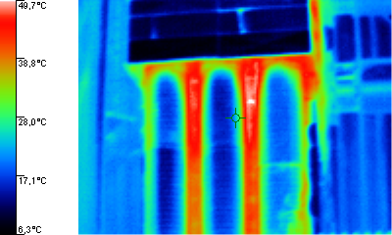
Thermovision

Slide 4
Problem solving
RH measurement calibration
Diary data from dryer operator
Flue gases recalculations
Air flow fluctuations
Weather conditions

Slide 5
Data processing
Drying statics
Drying dynamics
Drying kinetics
Process control

Slide 6
Study material
E-study
Instructions
Recommendations

Slide 7
Publications
2012 Biosystems Engineering
Recommendations for Dryer operator

Slide 8
Bachelor thesis
Allan Liiva - 2012 june
Grain dryer observation in Tartu region
Taavi Isup – 2012 june
Annikoru seed center grain dryer procces control and visualisation (Annikoru seemnekeskuse teraviljakuivati protsessi kontroll ja visualiseerimine)

Slide 9
Plans for the future
Portable device to monitoring output air RH
Modelling of drying process with simulink

Slide 10
Literature
Grube, Jens and Böckelmann, Markus. The harvest home and dry – key figures for grain drying. Cropping and machinery 2011
Matti Selinheimo. VIIKIN KOETILAN LÄMMINILMAKUIVURIN INSTRUMENTOINTI Helsinki 2008
Sencera Co. Ltd. H25K5A resistance humidity sensor specification. Taiwan 2002

Slide 11
Thanks for your attention ;)

