Slide 1
Energy to and from agriculture
View to future
Based on article
H. Mikkola and J. Ahokas

Slide 2
What is situation ?
Energy price rise
Ecological situation get worse
Human food need increase
Agriculture is based in fossil fuels
More scientific study is needed
The high technology will be used
Arable area will be decreased

Slide 3
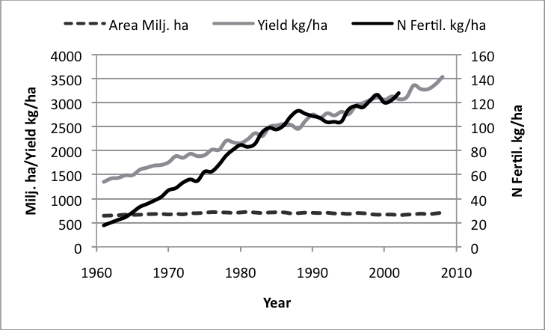
Crop production and fertilizer use

Slide 4
Solutions
In 2008 13% renewable energy (RE) were used
In EU the usage RE will be 20% to year 2020
Energy balance of agriculture will be positive
Energy saving in all technological process
Better recycling of nutrients
Recycling of the carbon dioxide

Slide 5
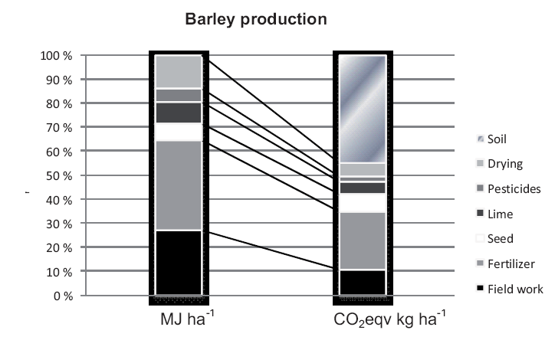
Energy use and CO₂ emissions

Slide 6
Bio Energy – positive or … ?
During production fossil fuel is used
Nitrogen fertilizer is used
Nitrous oxide 298x harmful than CO₂
Soil self emission make situation more favourable
Later on they (farmers) could also produce energy for themselves and in the best case for the market.

Slide 7
Potential of bio energy
Depends on population and fertilizer
45% arable area can be used
In year 2050 can fulfil between 30-40%
Ethanol production need 1:1 energy
Biodiesel is better – 1:2
Solid fuel direct burning is good
CHP efficiency can be increased considerably
Solid fuel energy ratio will be 1:30

Slide 8
Different aggregate
Solid
Liquid
Gaseous

Slide 9
Bio fuels problems
Is not so easy as fossil fuels using
Equipment need service (burner, engine etc.)
Emissions level will be high
Cold climate not suitable
Energy production differ from feed and food as the normal agricultural production. It need new knowledge.

Slide 10
Energy saving
Need motivation – fuel prices ;)
Price of fuel affect to the other price
Also the price on bioenergy
Energy use in plant and animal production and possibilities to save energy is considered in the future.

Slide 11
Literature
http://ph.eau.ee/~agronomy/vol08Spec1/p08s120.pdf

Slide 12
Thank for Your attention
Mart Hovi 2011

